Slide 1
Year 6 - Spring - Block 6
Ratio

Slide 2
Whitney lays tiles in the following pattern
If she has 16 red tiles and 20 yellow tiles remaining, can she continue her pattern without there being any tiles left over?
Explain why.

Slide 3
True or False?
For every red cube there are 8 blue cubes.
For every 4 blue cubes there is 1 red cube.
For every 3 red cubes there would be 12 blue cubes.
For every 16 cubes, 4 would be red and 12 would be blue.
For every 20 cubes, 4 would be red and 16 would be blue.

Slide 4
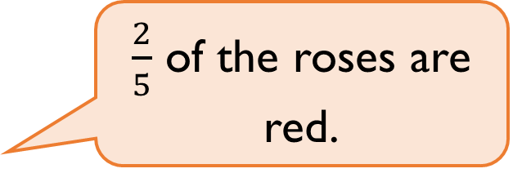
Ron plants flowers in a flower bed.
For every 2 red roses he plants 5 white roses.
He says,
Is Ron correct?
$\frac{2}{5}$ of the roses are red.

Slide 5
Which is the odd one out?
Explain your answer.

Slide 6
There are some red and green cubes in a bag.
$\frac{2}{5}$ of the cubes are red.
True or False?
For every 2 red cubes there are 5 green cubes.
For every 2 red cubes there are 3 green cubes.
For every 3 green cubes there are 2 red cubes.
For every 3 green cubes there are 5 red cubes.
Explain your answers.

Slide 7
Tick the correct statements.
There are two yellow tins for every three red tins.
There are two red tins for every three yellow tins.
The ratio of red tins to yellow tins is 2 $:$ 3
The ratio of yellow tins to red tins is 2 $:$ 3
Explain which statements are incorrect and why.

Slide 8
In a box there are some red, blue and green pens.
The ratio of red pens to green pens is 3 $:$ 5
For every 1 red pen there are two blue pens.
Write down the ratio of red pens to blue pens to green pens.

Slide 9
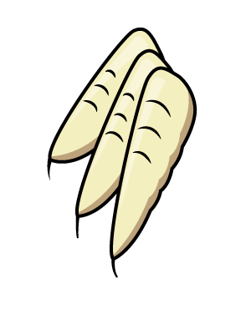
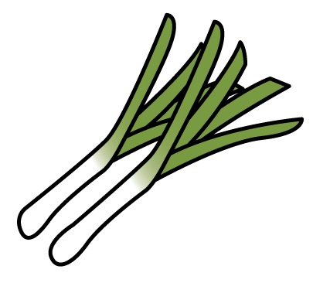
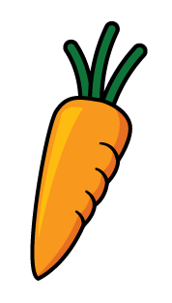
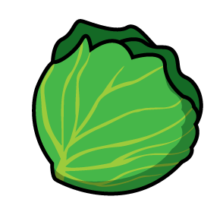
Teddy has two packets of sweets.
In the first packet, for every one strawberry sweet there are two orange sweets.
In the second packet, for every three orange sweets there are two strawberry sweets.
Each packet contains 15 sweets in total.
Which packet has more strawberry sweets and by how many?

Slide 10
Annie is making some necklaces to sell. For every one pink bead, she uses three purple beads.
Each necklace has 32 beads in total.
The cost of the string is £2.80
The cost of a pink bead is 72p.
The cost of a purple bead is 65p.
How much does it cost to make one necklace?

Slide 11
Draw a rectangle 3 cm by 4 cm.
Enlarge your rectangle by scale factor 2.
Compare the perimeter, area and angles of your two rectangles.

Slide 12
Here are two equilateral triangles.
The blue triangle is three times larger than the green triangle.
(Not drawn to scale)
Find the perimeter of both triangles.
5 cm

Slide 13
Jack says:
Do you agree?
Explain why.
The purple triangle is green triangle enlarged by scale factor 3
8 cm
5 cm
3 cm
6 cm
4 cm
7 cm

Slide 14
A rectangle has a perimeter of 16 cm.
An enlargement of this rectangle has a perimeter of 24 cm.
The length of the smaller rectangle is
6 cm.
Draw both rectangles.

Slide 15
Always, Sometimes, Never?
To enlarge a shape you just need to do the same thing to each of the sides.

Slide 16
Ron says that these three rectangles are similar.
Do you agree? Explain your answer.
2 cm
4 cm
6 cm
12 cm
10 cm
16 cm

Slide 17
This recipe makes 10 flapjacks.
Flapjacks
120 g butter
100 g brown sugar
4 tablespoons golden syrup
250 g oats
40 g sultanas
Amir has 180 g butter.
What is the largest number of flapjacks he can make?
How much of the other ingredients will he need?

Slide 18
Alex has two packets of sweets.
In the first packet, for every 2 strawberry sweets there are 3 orange.
In the second packet, for one strawberry sweet, there are three orange.
Each packet has the same number of sweets.
The second packet contains 15 orange sweets.
How many strawberry sweets are in the first packet?

